Slide 1
Blackwell Electronics
Customer Buying Patterns Report
June 12,2017
Analysis and correlations prepared by:
Clayton Ehrlich, Jon Heye, Lisa Landry, Jackie Nunes

Slide 2
Why Are We Here?
Today’s Objectives
Data Inputs
Use available data to describe specific actions Blackwell Electronics should take to increase revenue
Provide Blackwell Electronics leadership with a clear understanding of our confidence in these actions, both as a percentage and qualitatively
Sales Data Set to understand customers:
- Age of Customer
- Amount of items bought in purchase
- Amount Spent on purchase
- Region of Purchase
- Purchase made in-store or online
Product Data Set to understand:
- When are products purchased together
- What products could be recommended to increase amount of each customer interaction?

Slide 3
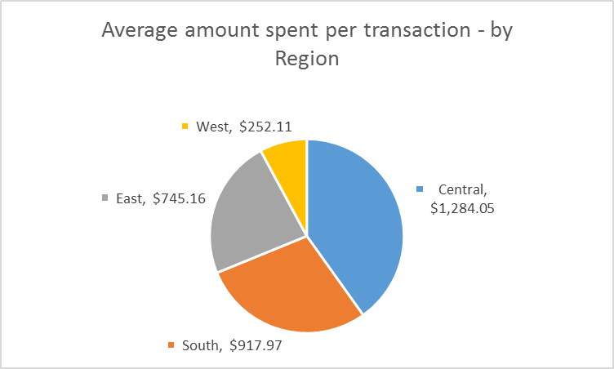
What can we say about the different regions?
The West region did not have any transactions over $1000. It also represents the lowest amount per transaction.
The East region did not have any transactions over $2000.
Only the South and Central regions had transactions over $2000.
Highest average spending per transaction by customers is in the Central region.

Slide 4
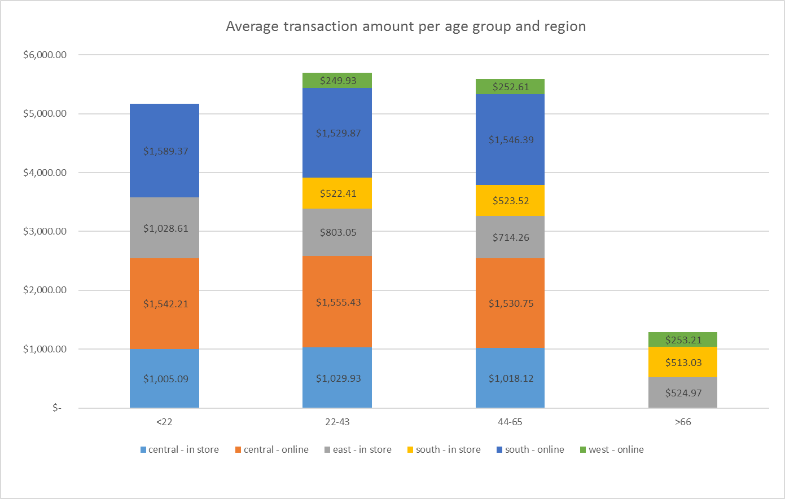
What Did We Find that was Interesting about the role Age plays?
All purchases in the Central region are by customers under 66 years of age.
This is the region with the highest average value per transaction.
There could be new revenue opportunity, but perhaps at a lower average transaction.
The Western region had the most purchases by customers over 66. The team recommends researching how this is achieved and what Central could do to reach out to these customers, possibly including:
Targeted Advertising
In Store Events and Education
Partnership with key associations such as AARP

Slide 5
Age: Clear finding in the Data
Yes, there is a strong relationship between age and whether the transaction was online or in-store. There is also an impact by region.
All purchases the West are online.
All purchases in the East are in-store.
Customers over the age of 44 buy more online.
Customers age 43 and under buy more in-store.
87% correlation between Age and whether the customer buys In-store

Slide 6
What does the product data set tell us?
Many products do not offer a cross-sell opportunity.
Sometimes products are purchased together without a clear rhyme or reason (e.g., candy)
The subsequent page represents the add-on products that made sense to suggest based on:
Profit margin being above an acceptable criteria (25%)
Logical coupling of with existing best sellers; These passed the ‘sniff’ test.

Slide 7
What future cross selling do we recommend?
Current Best Seller | Top 3 Recommendations for cross selling (where applicable)
1. Acer Aspire AS5750Z-4835 Laptop | Microsoft Office Home and Student 2010
 | Logitech Desktop MK120
 | Square Trade 3 Year Accidental Protection Warranty
2. Asus Zenbook Prime UX31A-DB51 Laptop | Microsoft Office Home and Student 2010
 | Logitech Desktop MK120
 | Square Trade 3 Year Accidental Protection Warranty
3. Sony VAIO T Series SVT13112FXS Laptop | Ibex 17 Inch Notebook Backpack
 | Square Trade 3 Year Accidental Protection Warranty
 | Dell Ultrasharp U2711 27 Inch
4. Sony L Series VPCL232FX/B Camera | Logitech C260
5. Alienware AAR4-10000BK Desktop | Logitech S120 2.0
 | Logitech Desktop MK120
 | Belkin Y Audio Cable
6. Logitech S120 2.0 Sound System | Belkin Y Audio Cable

Slide 8
What questions can data mining answer?
What new products if any should we consider?
Can we predict the sales revenue for these new products based upon existing sales of similar products?
Is there an age range or region we should target for more expensive purchases?
Is our eCommerce site competitive with our brick and mortar stores?
Are there patterns in the attributes of our best selling products? What attributes in these products are import to our

Slide 9
CEO Next Steps
Determine How Findings from this dataset could be leveraged. Options could include:
Allocate resource to adjusting dataset for gaps and re-run analysis
Allocate marketing resource to attracting new customers
Senior Citizens in the Central Region
Online sales in the East Region
Allocate marketing resources to increasing profitability of existing customers
Shift of millennials online
Training and sales collateral to improve ‘asking’ of the right cross-sell questions
Other – TBD – Let’s Discuss
Discuss other challenges the company is facing with the team, so we can collaborate on how to provide data analysis to assist. An example may include New Product Launch.
Please ask Questions!!!!

Slide 10
Appendix

Slide 11
Prediction Model – Amount Per Transaction
We can predict the amount a customer will spend by age range, whether in-store or online, and by region.

